Slide 1
CS 211: Computer Architecture Digital Logic (Combinational Circuits)
Abhishek Bhattacharjee
Reading:
Chapter 4: Section 4.2

Slide 2
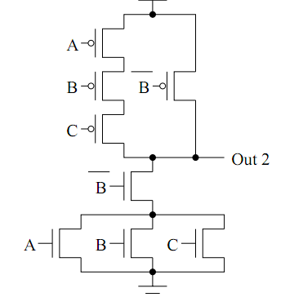
What is this?
A | B | C | Out
0 | 0 | 0
0 | 0 | 1
0 | 1 | 0
0 | 1 | 1
1 | 0 | 0
1 | 0 | 1
1 | 1 | 0
1 | 1 | 1
1
0
1
1
0
0
1
1

Slide 3
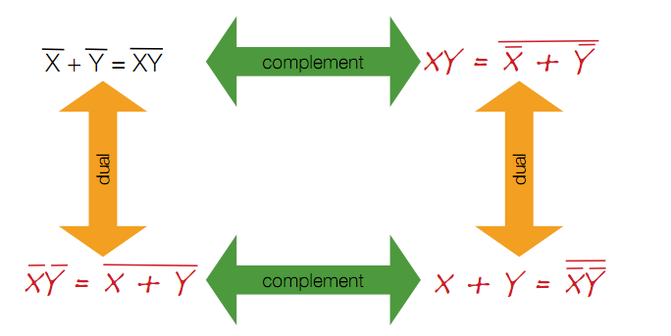
Relationship between Complement and Duals

Slide 4
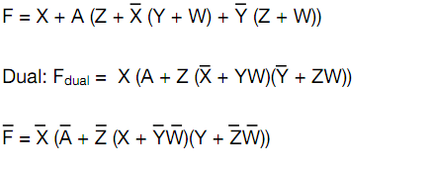
Complement Using Duals
Get dual and then complement each literal

Slide 5
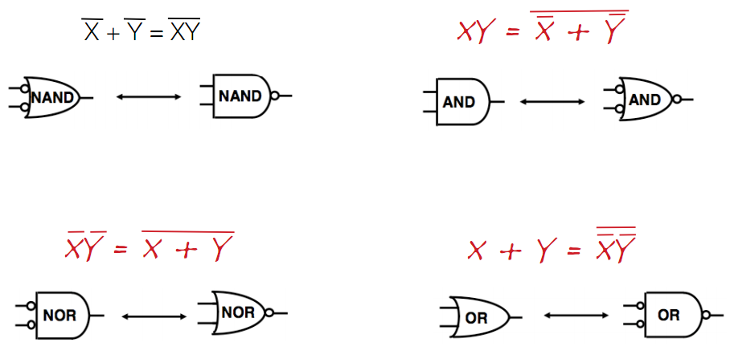
Using Duals for Gate Manipulation

Slide 6
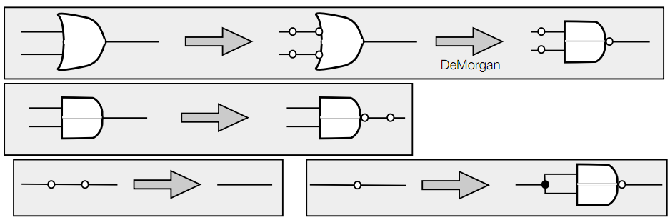
Converting Circuits to all-NAND (NOR)
Go from left to right
When manipulating AND/OR gate, stick in pairs of NOT gates
Isolated NOT gates can be implemented as NAND (NOR)

Slide 7
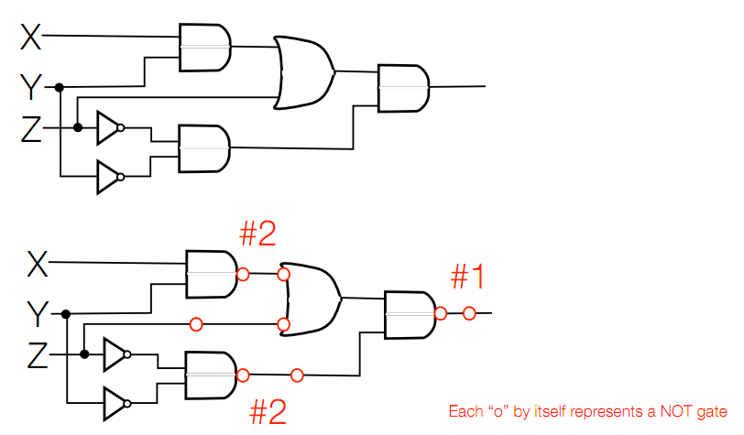
Example

Slide 8
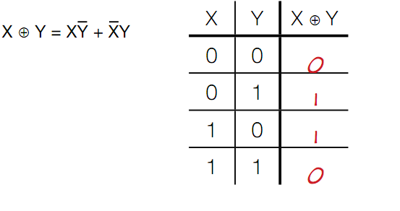
XOR: The parity operation
In general, represents parity (in general XOR of multiple variables is 1 when odd number of them are 1)

Slide 9
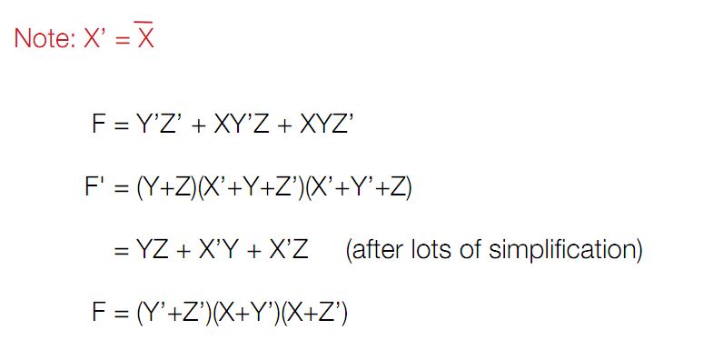
Canonical Forms
We have studied two canonical forms
Sum of Products (SoP)
Product of Sums (PoS)
How to convert to SoP from PoS (multiply through)
How to convert to PoS from SoP (complement, multiply through, complement via DeMorgan’s)

Slide 10
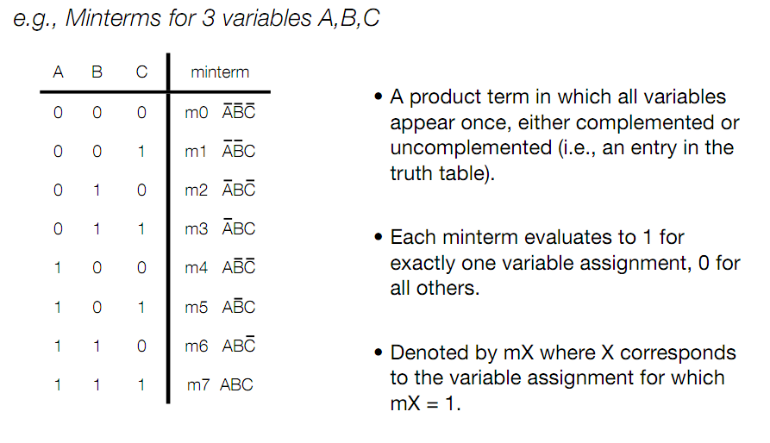
Formal Definition of Minterms

Slide 11
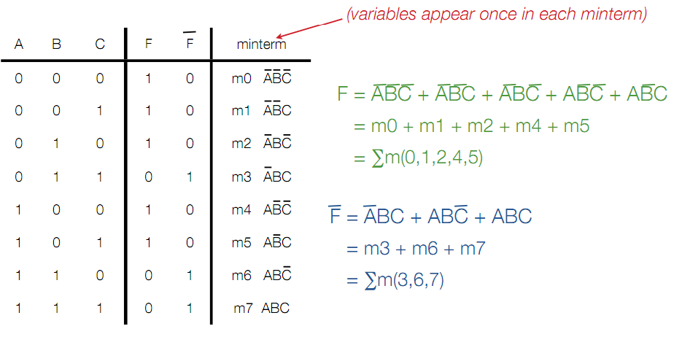
Minterm Example

Slide 12
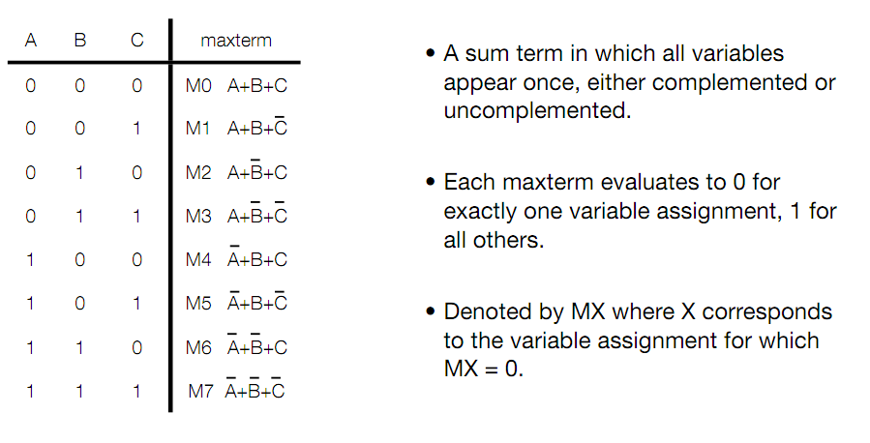
Formal Definition of Maxterms

Slide 13
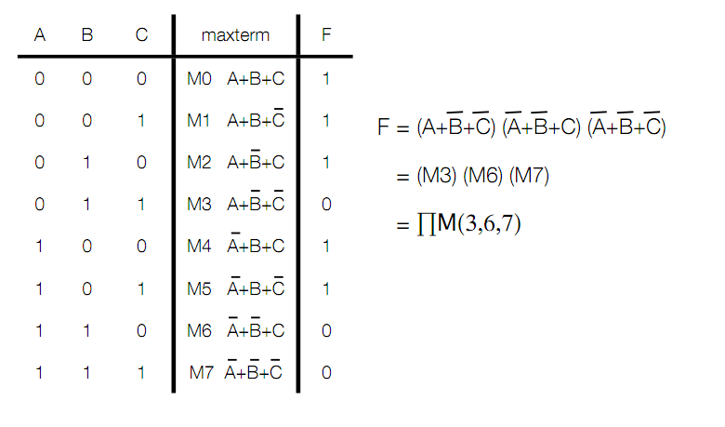
Maxterm Example

Slide 14
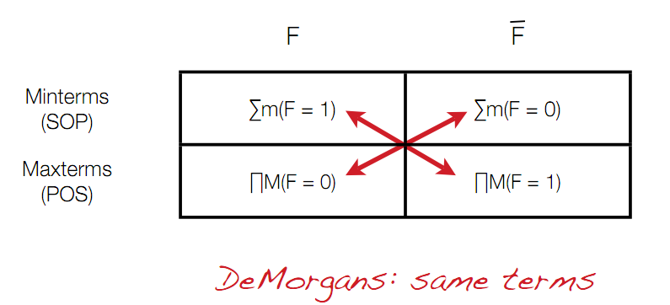
Converting Between Canonical Forms

Slide 15
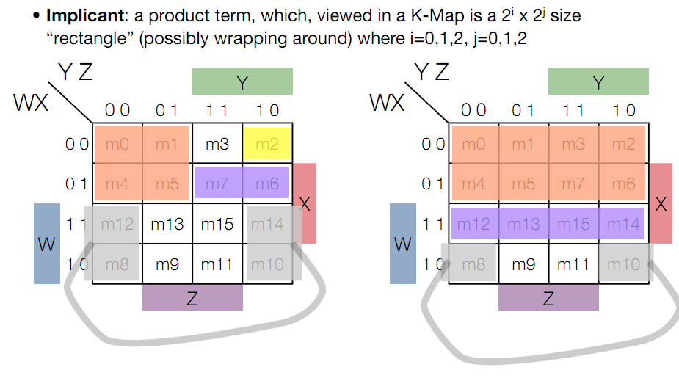
K-maps and Implicants

Slide 16
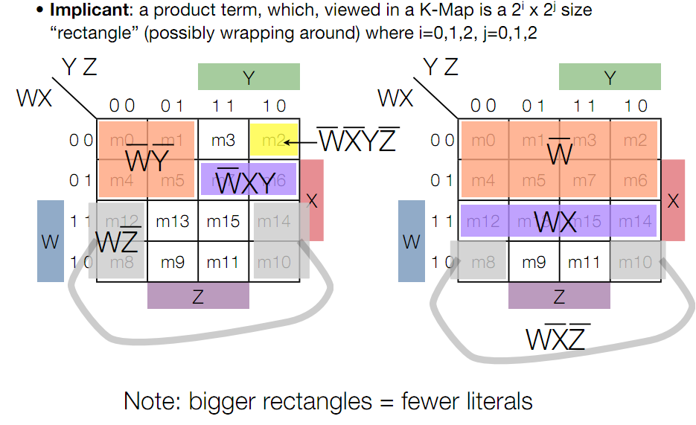
Implicants

Slide 17
More Implicant Terminology
Implicant: product term, which when viewed in a K-map, is a rectangle of 1s
Prime implicant: an implicant not contained in another implicant
Essential prime implicant: a prime implicant that is the only prime implicant to cover some minterm

Slide 18
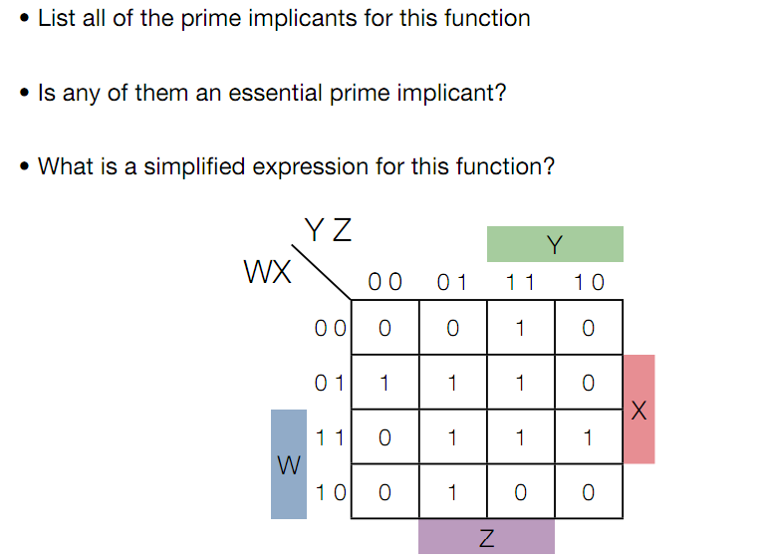
Example

Slide 19
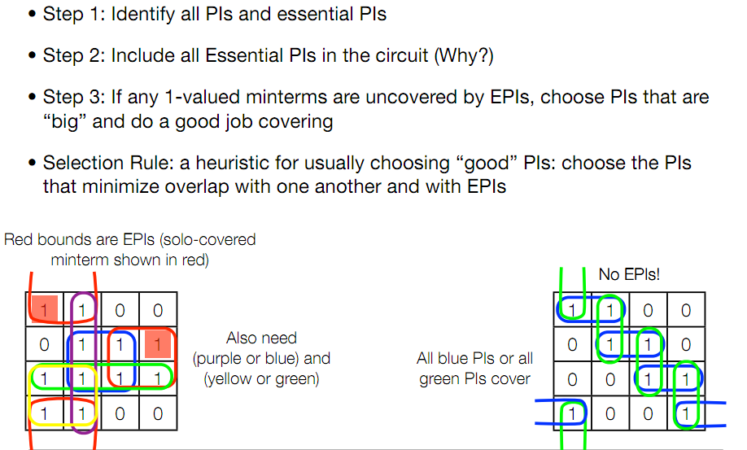
Example

Slide 20
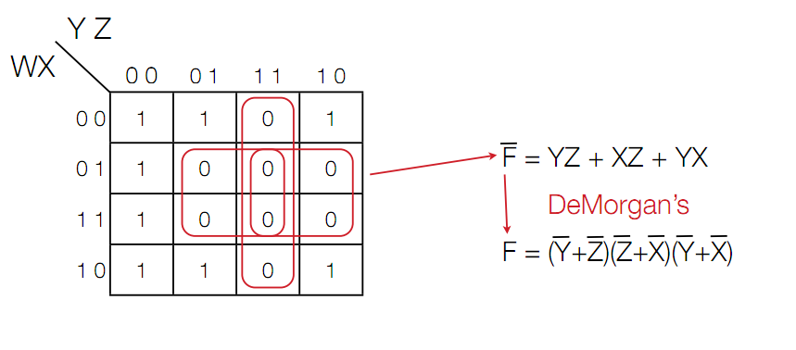
Product of Sums Example

Slide 21
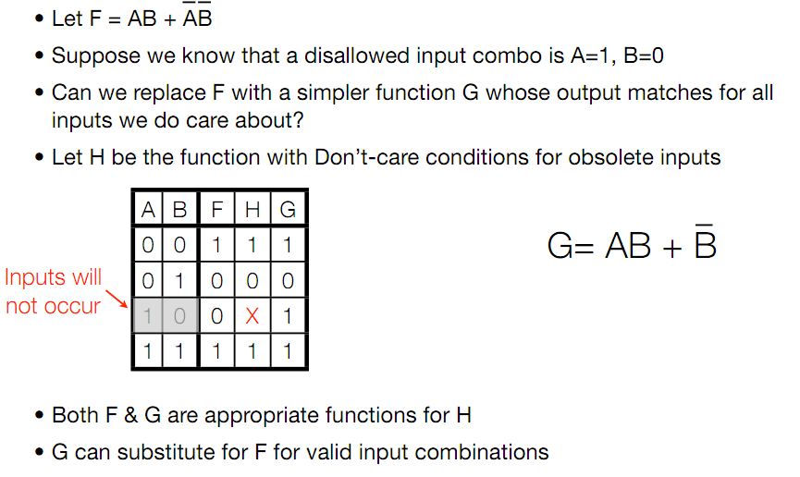
Don’t Care Conditions

Slide 22
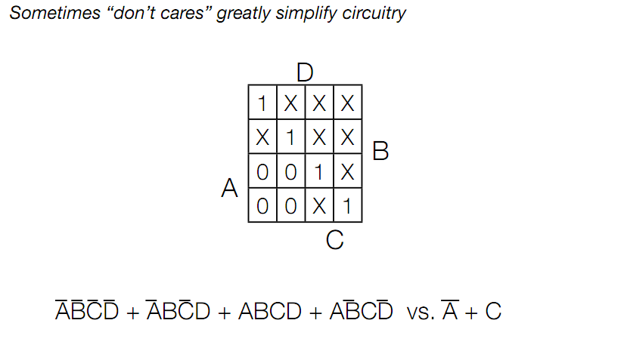
Don’t Cares can Greatly Simplify Circuits

Slide 23
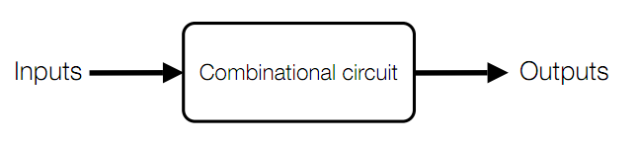
Combinational Circuits
Stateless circuits
Outputs are function of inputs only

Slide 24
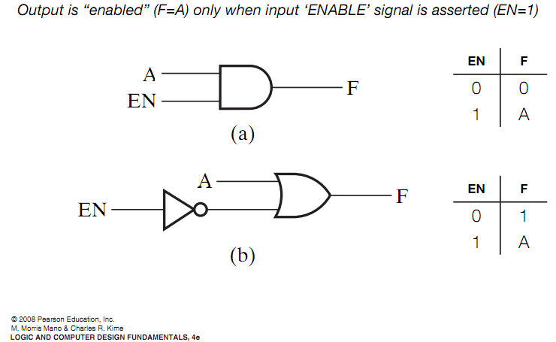
Enabler Circuits

Slide 25
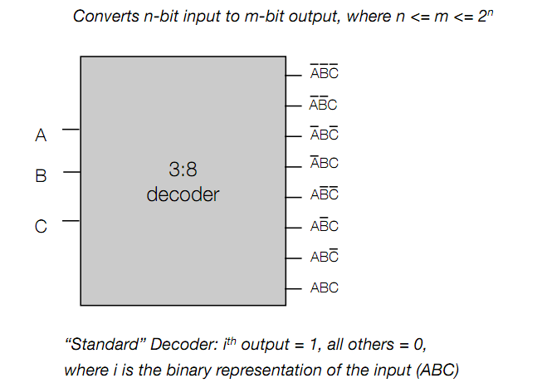
Decoder Circuits

Slide 26
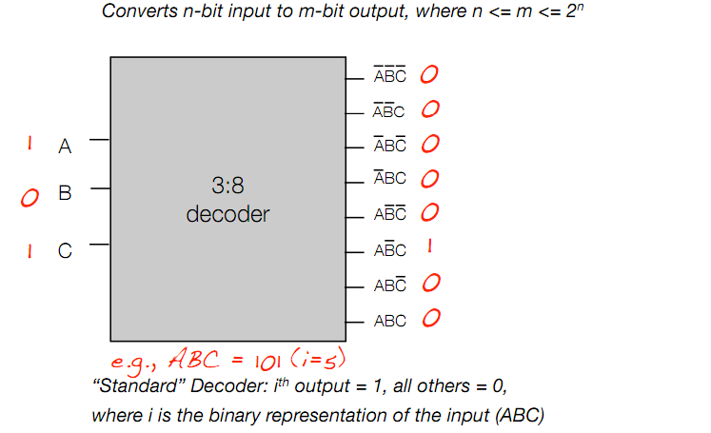
Decoder Example

Slide 27
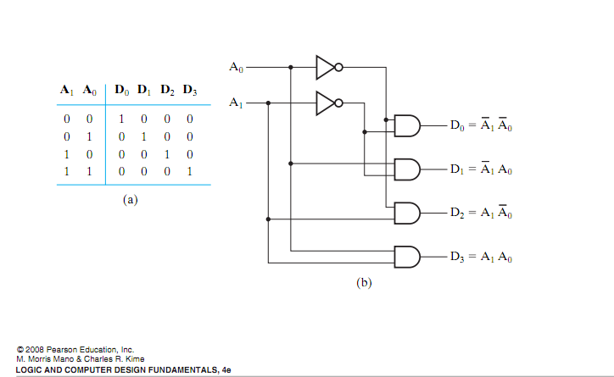
Internal 2:4 Decoder Design

Slide 28
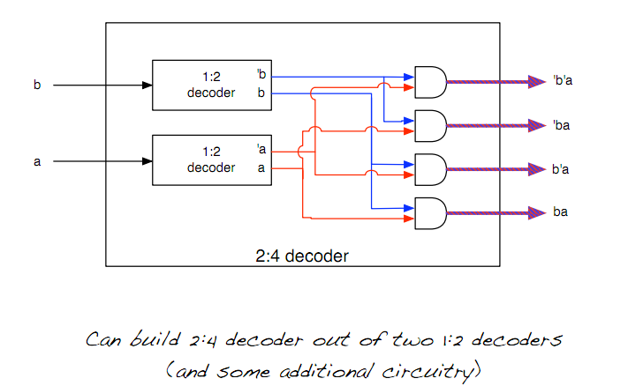
2:4 Decoder from 1:2 Decoders

Slide 29
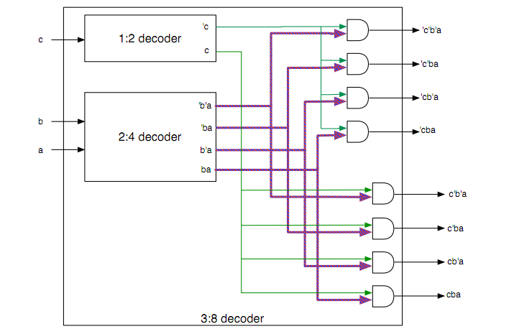
Hierarchical 3:8 Decoder

Slide 30
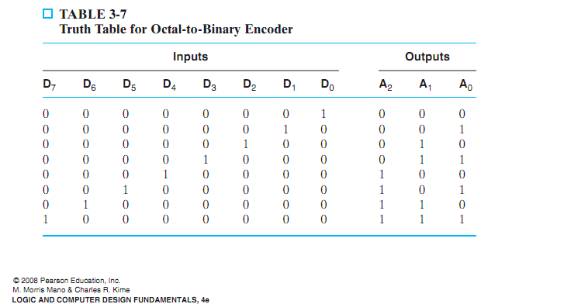
Encoder: Inverse of Decoder
Inverse of decoder: converts m bit input to n bit output
(n <= m)

Slide 31
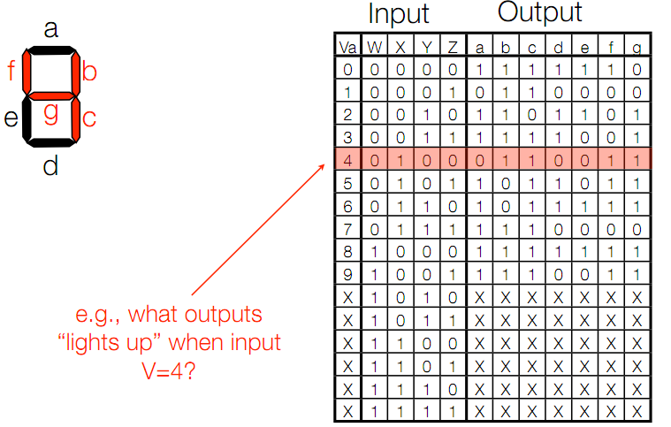
Design Example

Slide 32
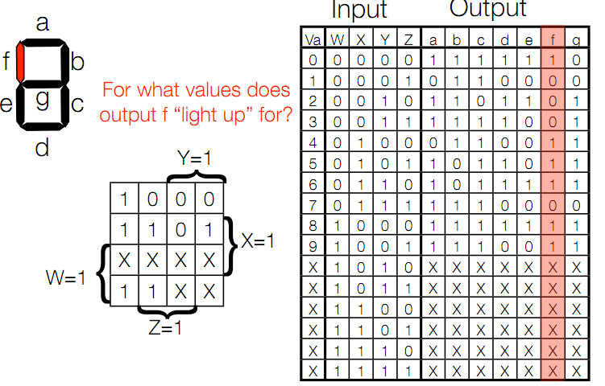
Design Example

Slide 33
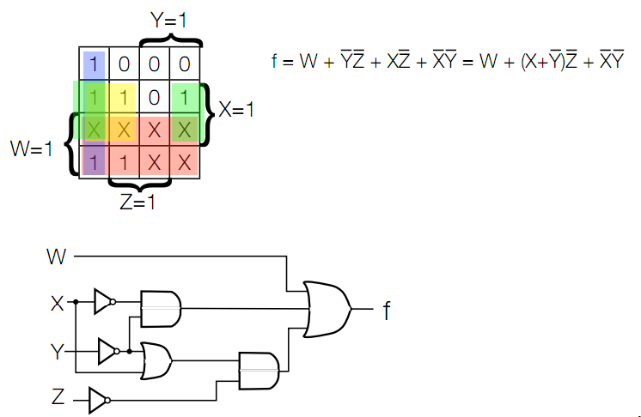
Design Example
We will do f, but you should be able to design a-e as well

